Slide 1
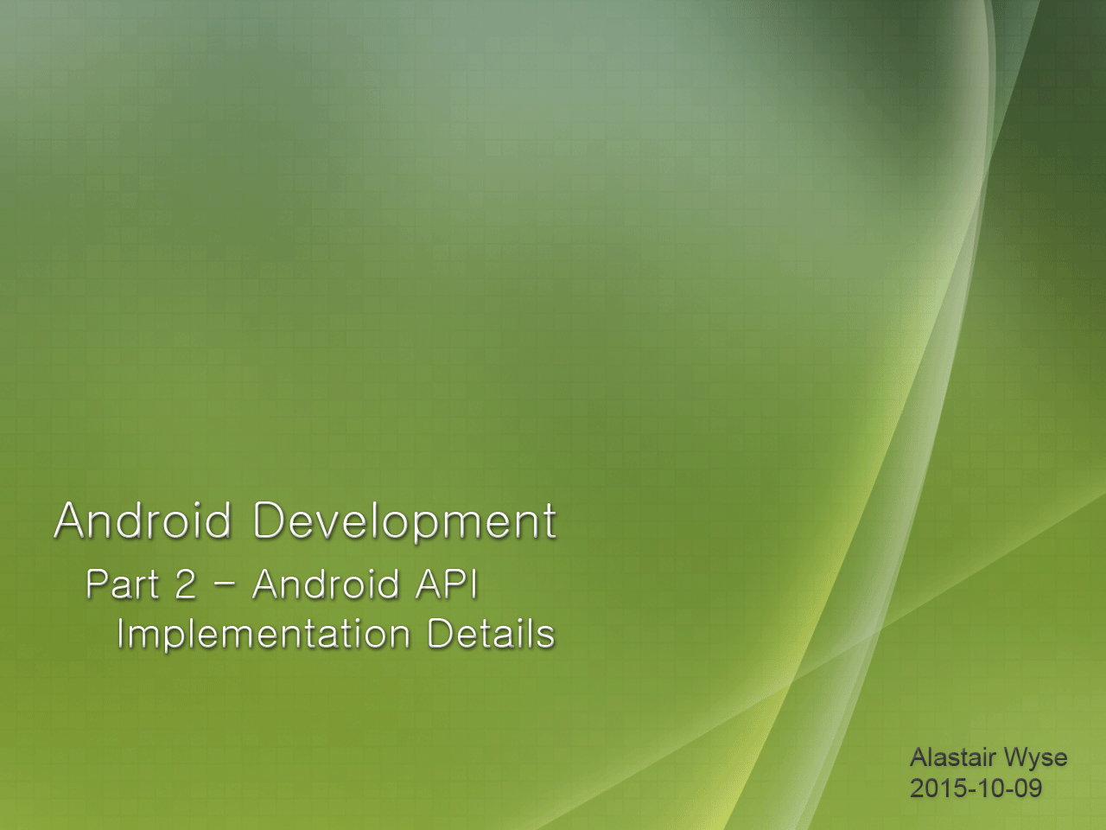

Slide 2
Recap of Part 1
Terminology
Windows Forms | Android | MVP
Form | Activity | View?
Control | View | View?
? | Service | Model?
Activities
Views / ViewGroups
Intents
Services

Slide 3
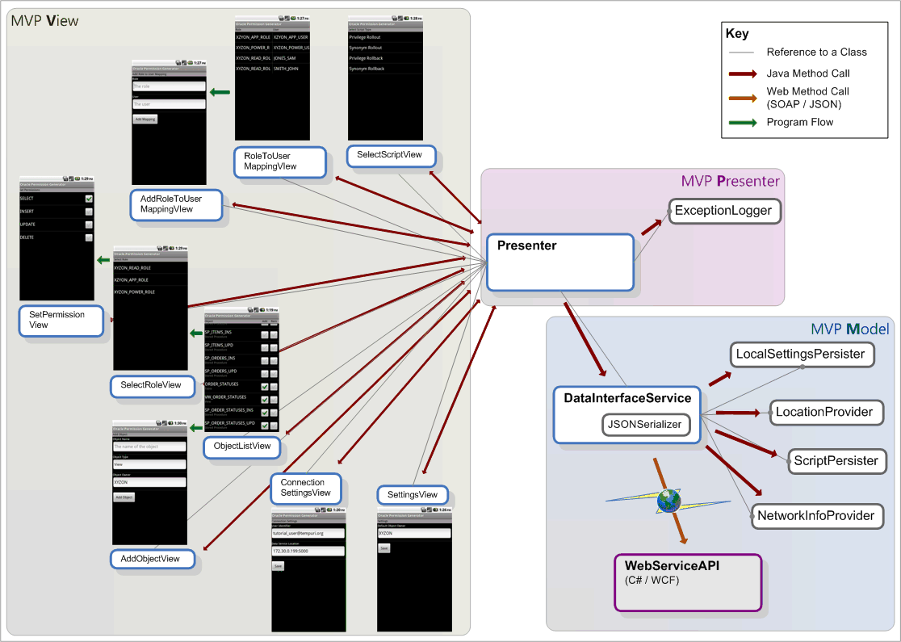
System Architecture

Slide 4
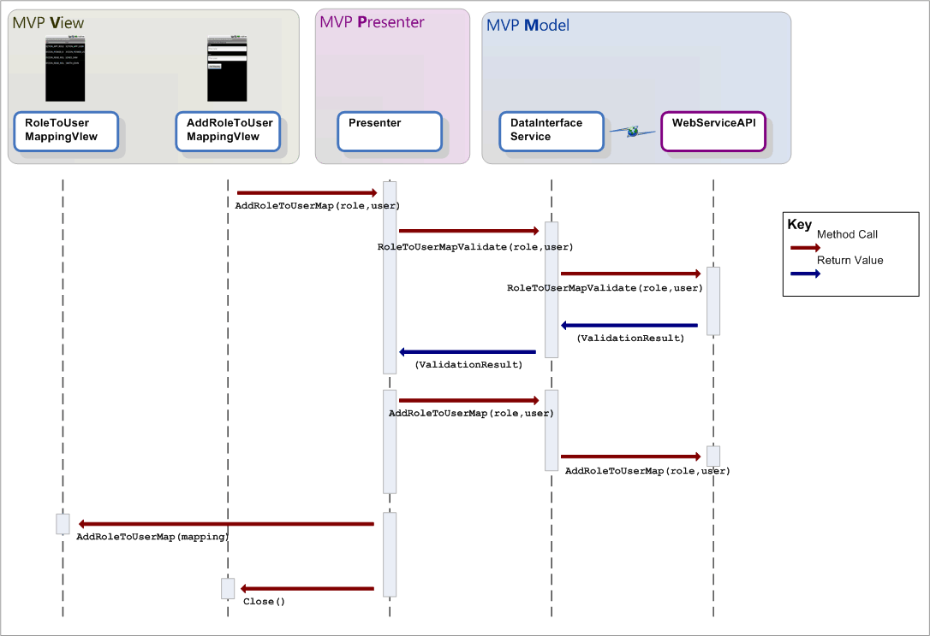
Typical MVP Component Interaction

Slide 5
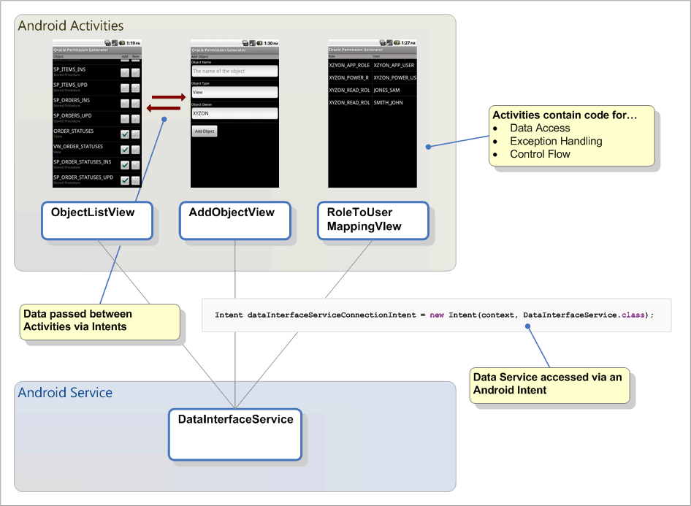
Android Interaction Model

Slide 6
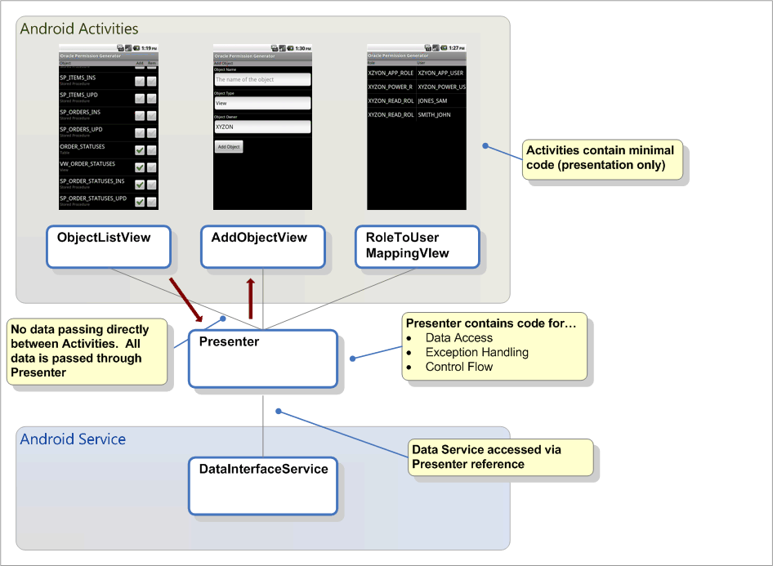
MVP Interaction Model (Applied to Android)

Slide 7
Obstacles to Implementing MVP
MVP requires bi-directional reference between View and Presenter
As Activity class is created by Android (not through explicit ‘new’), how does the Activity get a reference to the presenter?
Parameters can be passed to the constructor but only primitive types
Solution – to put the Presenter in a singleton

Slide 8
Obstacles to Implementing MVP
Many Android OS services require a Context object to be passed
Android Service class derives from Context, so can pass Service object when accessing Android services
However, Service itself requires a context to be started… this context has to be taken from an activity
This creates coupling between Activities (MVP View) and Services (MVP Model), and causes problems when coupled Activities are destroyed through orientation change or similar

Slide 9
Implementation Details - Views
View
TextView
EditText
Button
ViewGroup
LinearLayout
RelativeLayout

Slide 10
Implementation Details - ListViews
ListView is a special type of view whose content is retrieved from an array or collection of items
ListView must be ‘bound’ to a class deriving from ArrayAdapter<T>

Slide 11
Implementation Details - Activities
onCreate() method
Setting the layout
Linking to the Presenter
Click events
Setters / getters
onDestroy() and onBackPressed() methods

Slide 12
Implementation Details - Services
Recap - ‘Started’ vs ‘Bound’ services
A bound service is used to host the Model layer of the application
Starting the service is via an Intent
Binder and onBind() implementation
Connecting to the service

Slide 13
Implementation Details – Web Service Connection
REST / JSON are recommended protocol and serialization mechanism in Android
SOAP is supported by 3rd party library ksoap2
SOAP transport works well, but serialization requires granular parsing of XML documents
JSON is much easier to implement

Slide 14
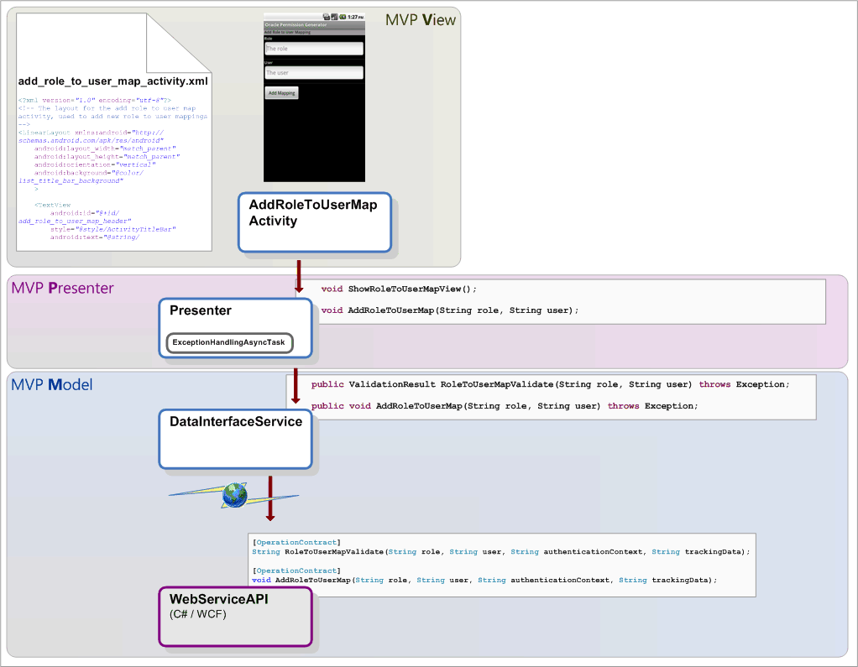
End-to-end Implementation

Slide 15
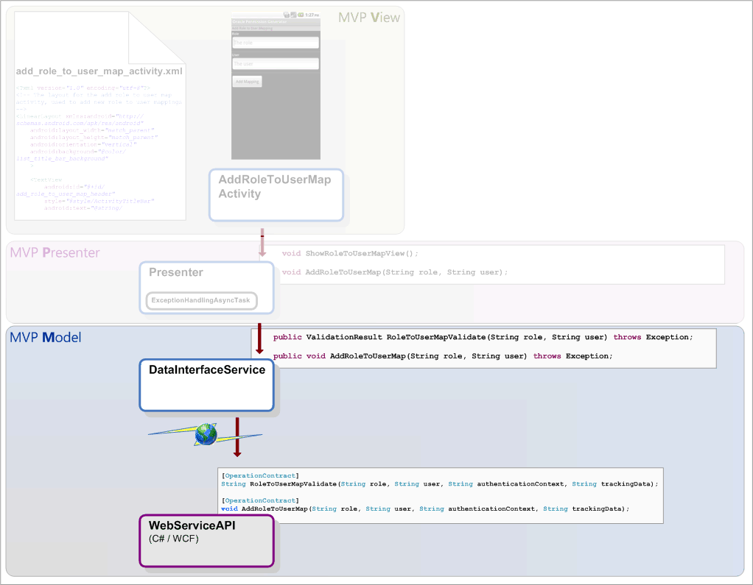
End-to-end Implementation - Model

Slide 16
End-to-end Implementation – WCF Side
Add required methods to the interface…
[OperationContract]
String RoleToUserMapValidate(String role, String user, String authenticationContext, String trackingData);
[OperationContract]
void AddRoleToUserMap(String role, String user, String authenticationContext, String trackingData);
Implement the methods…
public String RoleToUserMapValidate(String role, String user, String authenticationContext, String trackingData)
{
// Deserialize parameters
AuthenticationContext deserializedAuthenticationContext = jsonSerializer.DeserializeAuthenticationContext(authenticationContext);
// Call data layer method
ValidateUser(deserializedAuthenticationContext.UserIdentifier);
OraclePermissionGeneratorDataModel.ValidationResult validationResult = userDataRepository[deserializedAuthenticationContext.UserIdentifier].RoleToUserMapValidate(role, user);
Containers.ValidationResult returnValidationResult = containerObjectConverter.Convert(validationResult);
LogTrackingData(deserializedAuthenticationContext.UserIdentifier, "RoleToUserMapValidate(role, user)", trackingData);
return jsonSerializer.Serialize(returnValidationResult);
}

Slide 17
End-to-end Implementation – DataInterfaceService (Model)
Add required methods to the interface…
public ValidationResult RoleToUserMapValidate(String role, String user) throws Exception;
public void AddRoleToUserMap(String role, String user) throws Exception;
Implement the methods…
@Override
public ValidationResult RoleToUserMapValidate(String role, String user) throws Exception {
ArrayList<SoapProperty> parameters = new ArrayList<SoapProperty>();
parameters.add(new SoapProperty("role", role));
parameters.add(new SoapProperty("user", user));
Object result = MakeSoapRequest("RoleToUserMapValidate", parameters);
// Deserialize SOAP response
ValidationResult validationResult = jsonSerializer.DeserializeValidationResult(result.toString());
return validationResult;
}
Actual web method calls are made by code using ksoap2 objects

Slide 18
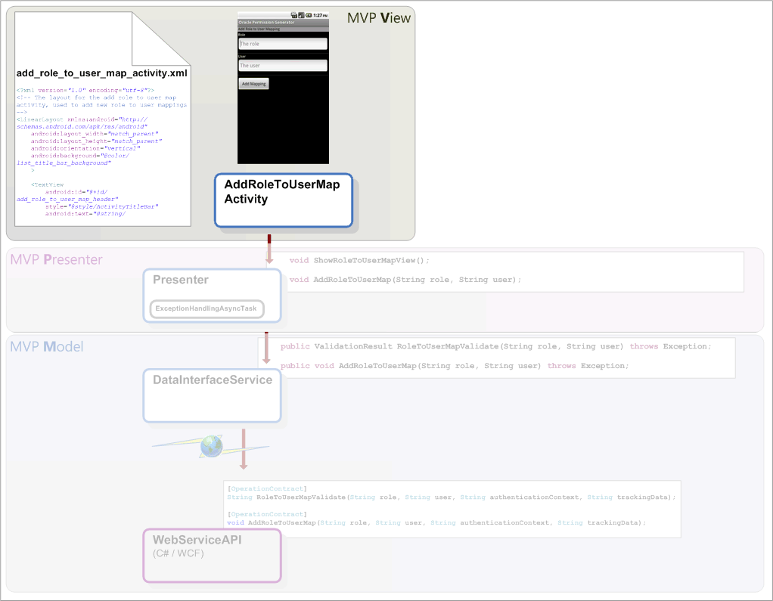
End-to-end Implementation - View

Slide 19
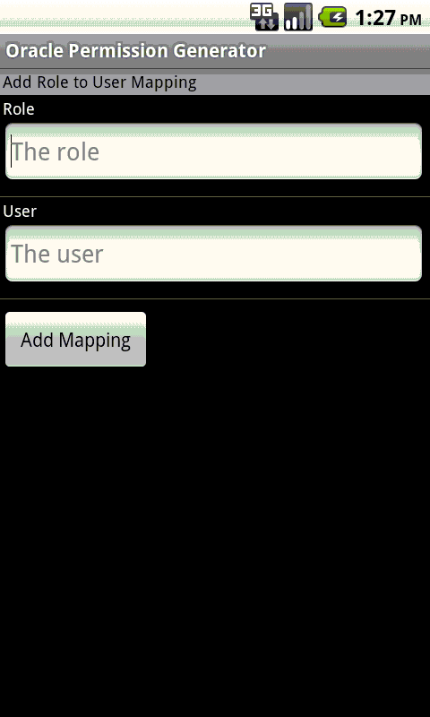
End-to-end Implementation – Layout XML
<?xml version="1.0" encoding="utf-8"?>
<!-- The layout for the add role to user map activity, used to add new role to user mappings -->
<LinearLayout xmlns:android="http://schemas.android.com/apk/res/android"
android:layout_width="match_parent"
android:layout_height="match_parent"
android:orientation="vertical"
android:background="@color/list_title_bar_background"
>
<TextView
android:id="@+id/add_role_to_user_map_header"
style="@style/ActivityTitleBar"
android:text="@string/add_role_to_user_map_header_text"
>
</TextView>
<LinearLayout
android:layout_width="match_parent"
android:layout_height="match_parent"
android:orientation="vertical"
android:background="@color/list_row_background"
>
<TextView
android:id="@+id/add_role_to_user_map_role_field_title"
android:layout_width="match_parent"
style="@style/InputFieldTitle"
android:text="@string/add_role_to_user_map_role_field_title_text"
>
</TextView>
<EditText
android:id="@+id/add_role_to_user_map_role_field"
android:layout_width="match_parent"
android:layout_height="wrap_content"
style="@style/InputField"
android:hint="@string/add_role_to_user_map_role_field_hint_text"
android:maxLength="30"
android:layout_marginBottom="12dip"
>
</EditText>

Slide 20
End-to-end Implementation – Activity
Implement the onCreate() method…
Set the context to the previously created XML layout
Link to the presenter
@Override
protected void onCreate(Bundle savedInstanceState) {
super.onCreate(savedInstanceState);
setContentView(R.layout.add_role_to_user_map_activity);
presenter = PresenterGlobalStorer.getPresenter();
presenter.setAddRoleToUserMapView(this);
}
Implement button click handler
public void AddMappingButtonOnClickListener(View view) {
// Get the contents of the fields in the activity
String role = ((EditText)findViewById(R.id.add_role_to_user_map_role_field)).getText().toString().trim();
String user = ((EditText)findViewById(R.id.add_role_to_user_map_user_field)).getText().toString().trim();
presenter.AddRoleToUserMap(role, user);
}

Slide 21
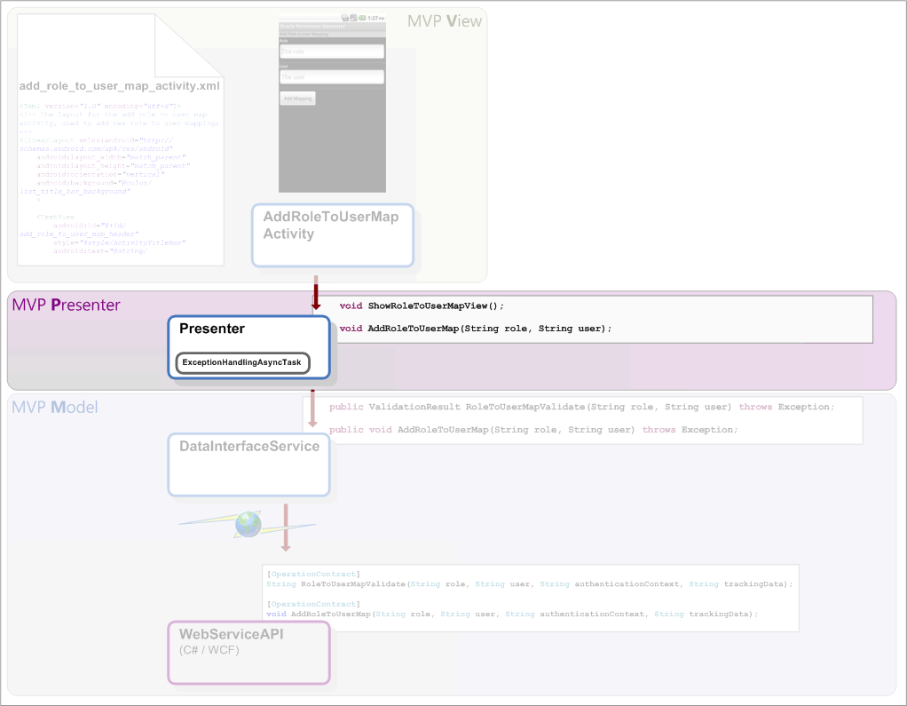
End-to-end Implementation - Presenter

Slide 22
End-to-end Implementation – Presenter
Implement a method to display the Activity - ShowAddRoleToUserMapView()
This method does not need to access the DataInterface, so can run in the main thread
New Activities are started via an Intent
@Override
public void ShowAddRoleToUserMapView() {
Context roleToUserMapViewContext = (Context)roleToUserMapView;
Intent showAddRoleToUserMapViewIntent = new Intent(roleToUserMapViewContext, AddRoleToUserMapActivity.class);
roleToUserMapViewContext.startActivity(showAddRoleToUserMapViewIntent);
}

Slide 23
End-to-end Implementation – Presenter
Implement a method to handle the button click - AddRoleToUserMap()
This method does need to access the DataInterface, so needs to run on a separate thread
The Andoid AsyncTask class can be used for this

Slide 24
End-to-end Implementation – AsyncTask
Generic class with type parameters to define…
Type of data sent to the worker thread
Type of units to report progress of the worker thread task
Type of data to be returned from the worker thread
Contains 4 methods which can be overridden in derived classes to control the behavior…
onPreExecute() - Invoked on the UI thread before executing the worker thread code
doInBackground(Params...) - The worker thread code
onProgressUpdate(Progress...) - Invoked on the UI thread when a report of updated progress is made
onPostExecute(Result) - Invoked on the UI thread after the worker thread completes

Slide 25
End-to-end Implementation – AsyncTask
For this project I created a derived version of AsyncTask called ExceptionHandlingAsyncTask
Provides the following additional functionality
Displays a ‘retry’ message if the worker thread code fails due to a network exception
Displays a ‘fatal’ message if the worker thread code fails due to another exception type, and attempts to log the exception
Displays a modal ‘please wait’ message while the worker thread is running

Slide 26
End-to-end Implementation – Presenter
AddRoleToUserMap() implementation…
doInBackground() method validates the parameters and adds the mapping if the validation is successful
onPostExecute() method either shows an error message, or updates the RoleToUserMapView with the new mapping and closes the AddRoleToUserMapView

Slide 27
End-to-end Implementation – Final Steps
Call to presenter ShowAddRoleToUserMapView() method (from context menu)
Adding Activity definition to the Manifest file
Creating styles
Write unit tests!

Slide 28
User Behavior Tracking
Benefits of tracking user behavior
Better understanding of how your customers are using the software
Better understanding of where your customers are using the software
Know where to focus improvements / enhancements
Customize the UI to suit specific user’s interaction
Anonymized behavior data could be valuable

Slide 29
User Behavior Tracking - Implementing
Need to define required permissions in the manifest file
User is prompted to confirm these permissions when installing the app
Using the LocationProvider and NetworkInfoProvider classes to retrieve the device location and IP address
Storing data in the .NET / WCF side

Slide 30
Synchronous vs Asynchronous Operation
Android API is designed around an asynchronous paradigm
Sometimes makes it difficult to perform synchronous operations (e.g. display a modal message window)
A different approach / thinking is required for asynchronous design
Client side caching of data and/or operations may be required

Slide 31
In Hindsight…
Alternative approaches to implementing MVP…
Could the MVP pattern be better represented using an Activity as the presenter, and having multiple presenters?
Could the presenter be run as an Android service?

Slide 32
Next Steps / Improvements
Less ‘chatty’ web service interface
Client-side caching of data changes – ability to work ‘disconnected’
Add option to use REST/JSON web service
Add option to save permission scripts to SD card
More unit tests (especially DataInterfaceService)
‘Lazy’ population of ListViews
Proper multi-threading support on .NET / WCF side
Better user authentication and security
Handle landscape orientation changes

Slide 33
Links
Android API Reference
http://developer.android.com/reference/packages.html
Vogella Android Tutorials
http://www.vogella.com/tutorials/android.html
Google I/O - Android REST client applications
https://www.youtube.com/watch?v=xHXn3Kg2IQE
Project Source Code
https://github.com/alastairwyse/OraclePermissionGeneratorAndroid
Project Tutorial
http://www.oraclepermissiongenerator.net/oraclepermissiongeneratorandroid/

